Slide 1

SHREE RAMSWAROOP MEMORIAL UNIVERSITY
Assignment:-12
Java Enterprise Edition Lab - 12
Submitted to:
Submitted by:
Vidushi Srivastava
Mukesh Prajapati
Btech (Cse Industry integrated)
Roll No – 202410101230007

Slide 2
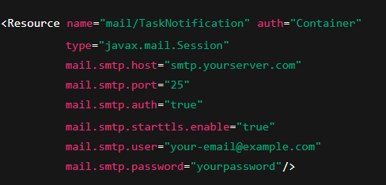
1. JNDI Configuration for Email Server
To send email notifications, configure a JNDI resource in Tomcat’s server.xml file:

Slide 3
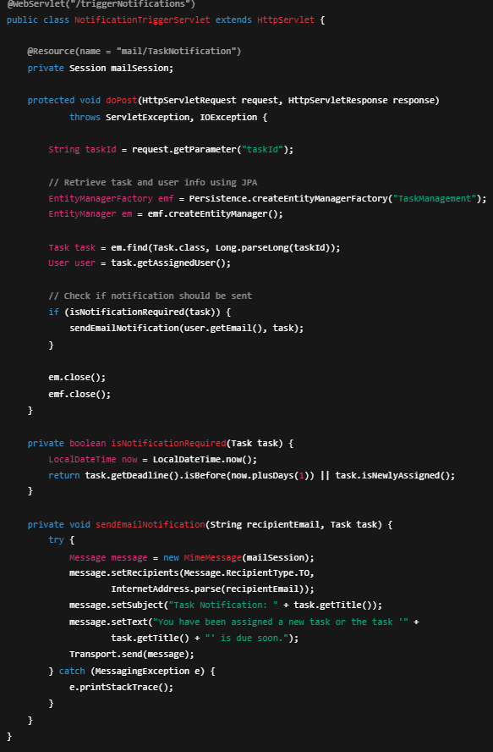
2. NotificationTriggerServlet
This servlet triggers notifications when a task event (e.g., new assignment or deadline approaching) occurs.

Slide 4
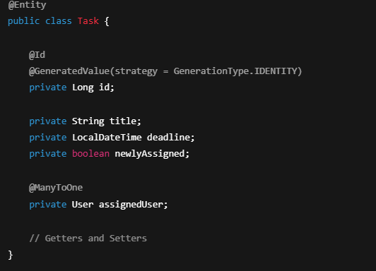
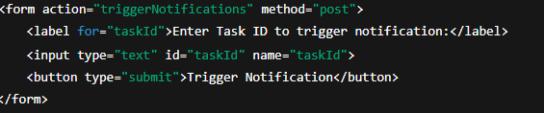
3. Task Entity (JPA)
Ensure the Task entity has fields for deadline, isNewlyAssigned, and assignedUser.
4. Example JSP (Notification Trigger UI)
For demonstration, create a simple JSP form to manually trigger a notification.

Slide 5


Execution Flow
User enters Task ID in the JSP form.
The form submits to NotificationTriggerServlet.
The servlet retrieves the task using JPA.
If a notification condition is met (new assignment or nearing deadline), an email is sent via the JNDI-configured mail session.
Expected Output (Example)
Email Notification Content:
Browser Output (triggerNotification.jsp):

